Slide 1





Einar och Majlill
Pensionär
65 år eller äldre
Man/kvinna.
150 000kr+ årsinkomst
Kontroversiell och håller sig till varumärken den känner till.
“Jag tränar för att hålla mig frisk”
Notes:
Here’s a relatively simple, single slide example.
Let’s disect this:
One of the key things, regardless of level of detail, is to make it memorable.
You can do this by giving your persona a name and a tagline that cuts right to the heart of what he or she is about, add a, photo, age, and any relevant brands or logos too. Ideally ones that you heard some of your subjects talk about in research.
As you create these, make sure to keep focus on designable traits, and stay true to your data.
Ex.
Hypothetically let’s say you say these trends in user testing:
They’re in their 40s. They work hard. They make a lot of money. They don’t have a lot of time.
They mostly have set routine. Make mostly rational decisions about which products they use.
Ex. They read a lot of reviews and then once they make a decision, they are very loyal.
You might sum up those related behaviors you saw in research by calling this persona, the
Time starved professional. Also giving him a real name, Vince, for easy reference. Distilling your observations for this type of person into the following:
[read points]

Slide 2
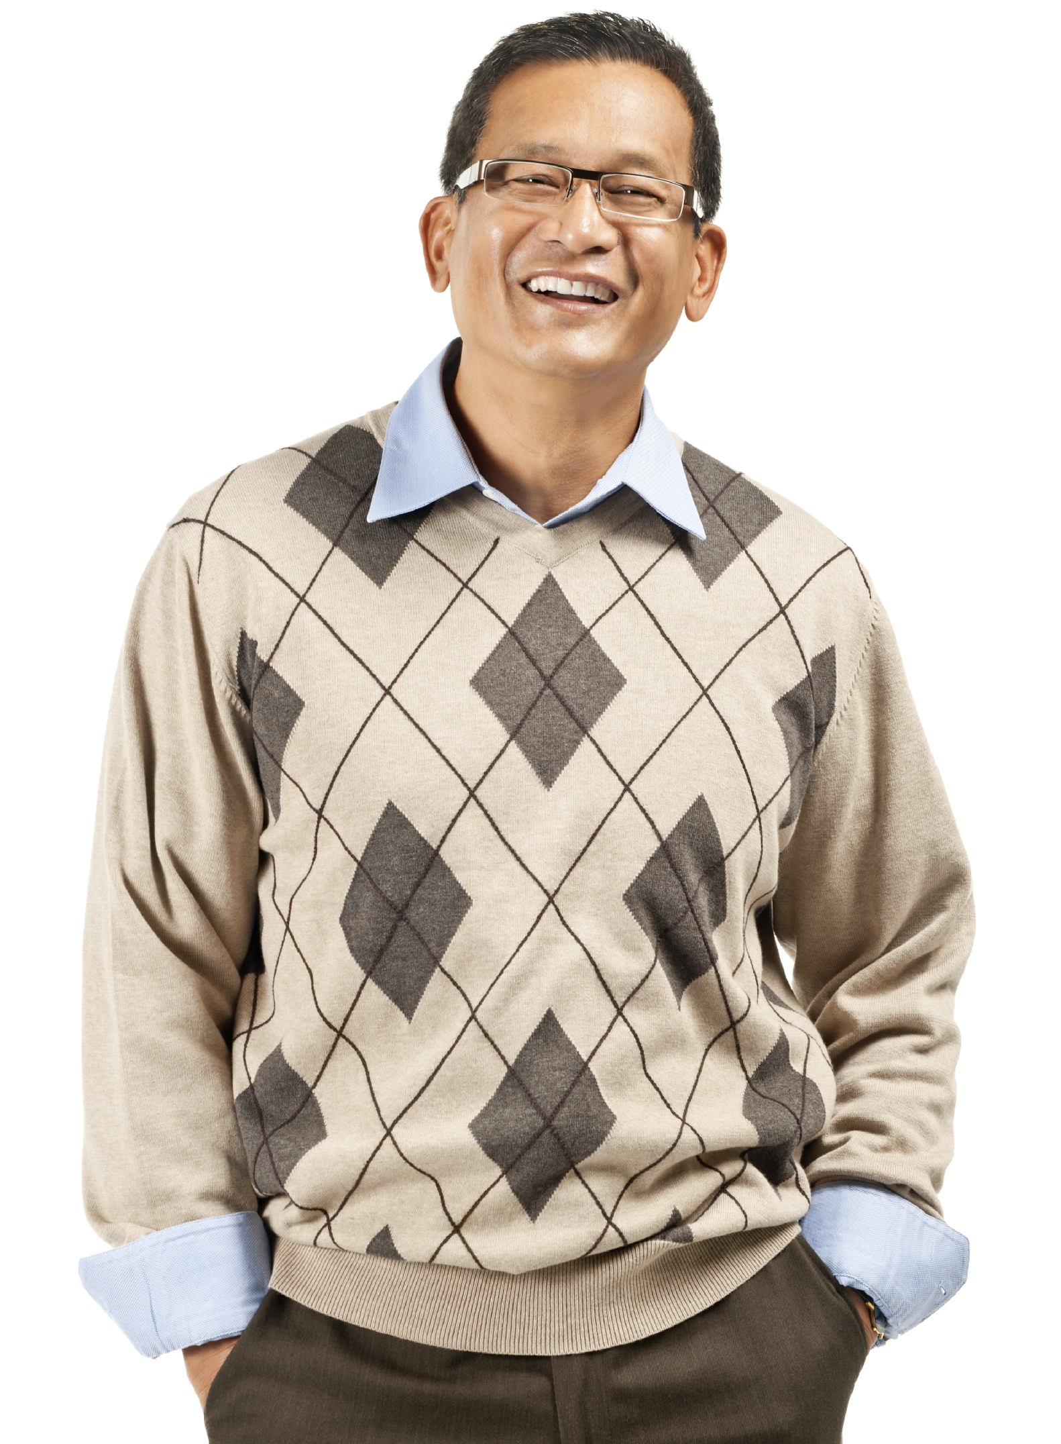



Hans – Medelålders mannen
Medelåldersmannen
40 år.
336 000kr+ årsinkomst
Har begränsat med tid och familj.
“Jag tränar för att hålla mig snygg och frisk. Träning ska vara på mina vilkor.”
Notes:
Here’s a relatively simple, single slide example.
Let’s disect this:
One of the key things, regardless of level of detail, is to make it memorable.
You can do this by giving your persona a name and a tagline that cuts right to the heart of what he or she is about, add a, photo, age, and any relevant brands or logos too. Ideally ones that you heard some of your subjects talk about in research.
As you create these, make sure to keep focus on designable traits, and stay true to your data.
Ex.
Hypothetically let’s say you say these trends in user testing:
They’re in their 40s. They work hard. They make a lot of money. They don’t have a lot of time.
They mostly have set routine. Make mostly rational decisions about which products they use.
Ex. They read a lot of reviews and then once they make a decision, they are very loyal.
You might sum up those related behaviors you saw in research by calling this persona, the
Time starved professional. Also giving him a real name, Vince, for easy reference. Distilling your observations for this type of person into the following:
[read points]

Slide 3


Kristina
Medelålderskvinnan
40 år.
300 000kr+ årsinkomst
Har begränsat med tid och familj.
“Tränar för att det är roligt och för att hålla mig snygg. Jag gillar att gå på träningspass.”
Notes:
Here’s a relatively simple, single slide example.
Let’s disect this:
One of the key things, regardless of level of detail, is to make it memorable.
You can do this by giving your persona a name and a tagline that cuts right to the heart of what he or she is about, add a, photo, age, and any relevant brands or logos too. Ideally ones that you heard some of your subjects talk about in research.
As you create these, make sure to keep focus on designable traits, and stay true to your data.
Ex.
Hypothetically let’s say you say these trends in user testing:
They’re in their 40s. They work hard. They make a lot of money. They don’t have a lot of time.
They mostly have set routine. Make mostly rational decisions about which products they use.
Ex. They read a lot of reviews and then once they make a decision, they are very loyal.
You might sum up those related behaviors you saw in research by calling this persona, the
Time starved professional. Also giving him a real name, Vince, for easy reference. Distilling your observations for this type of person into the following:
[read points]

Slide 4



Emelie
Ung kvinna
22 år+
220 000 kr+ årsinkomst
Jobbar mycket och har ett aktivt privatliv.
“Jag behöver ett brett utbud av gruppträningspass och en fräsch miljö”
Notes:
Try to use this template if you can. It’s nice and simple.

Slide 5



Stefan
Ung man
22 år+
240 000 kr+ årsinkomst.
Har jobbar mycket och har ett aktivt privat liv.
“Ett stort utbud av fria vikter och en fräsch maskinpark, men även möjligheten att träna när jag vill.
Notes:
Try to use this template if you can. It’s nice and simple.

